Slide 1
Java Server Pages (JSP)

Slide 2
Road Map
Getting Started with JSP: Dev Environment
Explore JSP scripting elements
Reading HTML form data with JSP
Manage application state with Cookies and Sessions
and much more …

Slide 3
Overview
What are Web Applications?
What are JSP and Servlets?
What types of apps can you create?

Slide 4
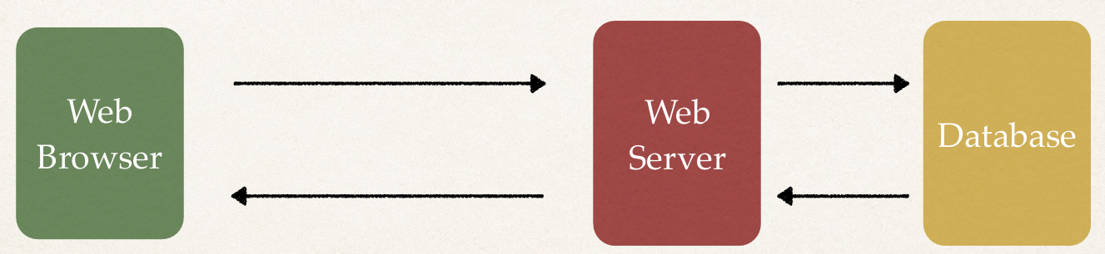
Web Applications
A web site where the HTML pages are generated dynamically
Based on the user’s actions

Slide 5
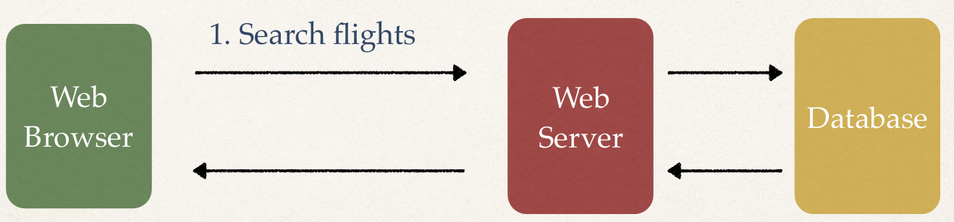
Web Applications
A web site where the HTML pages are generated dynamically
Based on the user’s actions

Slide 6
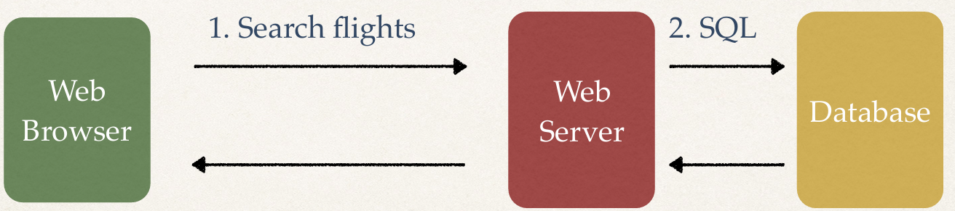
Web Applications
A web site where the HTML pages are generated dynamically
Based on the user’s actions

Slide 7
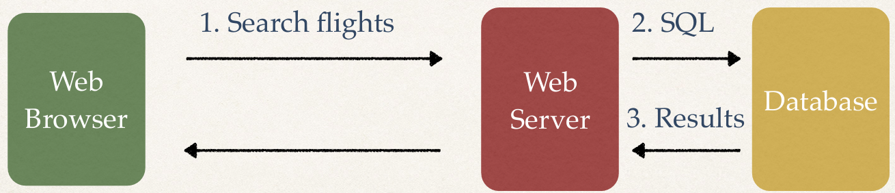
Web Applications
A web site where the HTML pages are generated dynamically
Based on the user’s actions

Slide 8
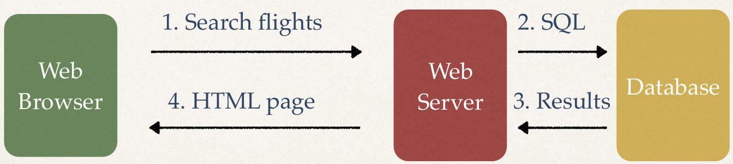
Web Applications
A web site where the HTML pages are generated dynamically
Based on the user’s actions

Slide 9
What are JSPs and Servlets?
Java code that runs on the web server
Reads user’s actions … normally from HTML Form
Performs the work
Returns an HTML page that is generated dynamically

Slide 10
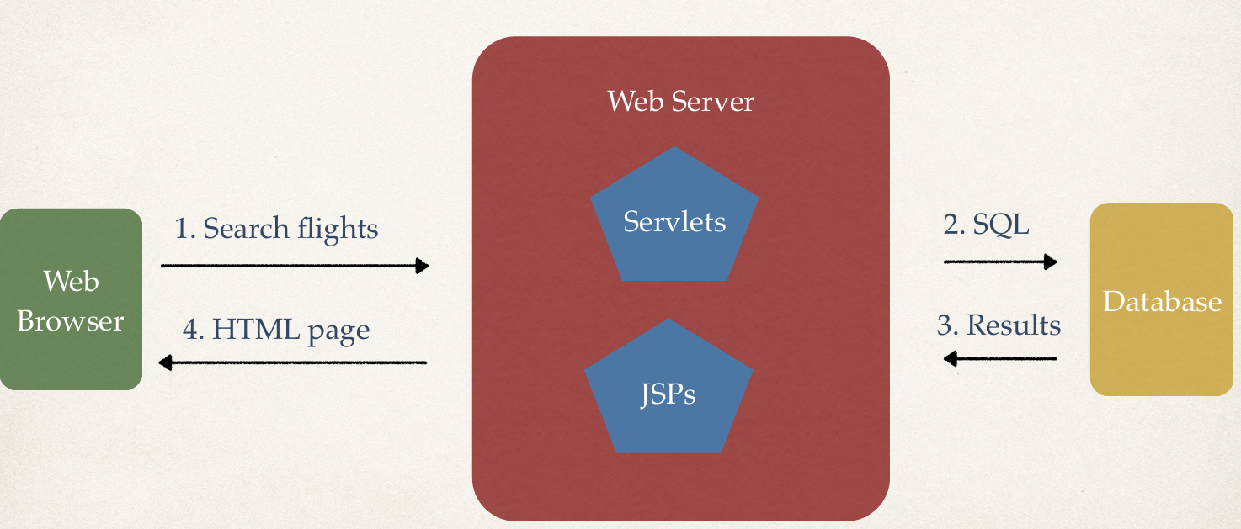
What are JSPs and Servlets?

Slide 11
What Types of Web Apps can you create?
Any industry …
E-commerce
Student / Employee Tracking
Restaurant / Hotel Reservations
Social Media
Any type of app … no limits … be creative ☺

Slide 12
Key Building Blocks
JSPs and Servlets are key components of the Java Enterprise Edition (Java EE)
Popular MVC frameworks are actually built on top of JSP and Servlets
Spring
JSF
Struts

Slide 13
Required Software
JDK
Apache Tomcat
IDE (Eclipse)

Slide 14
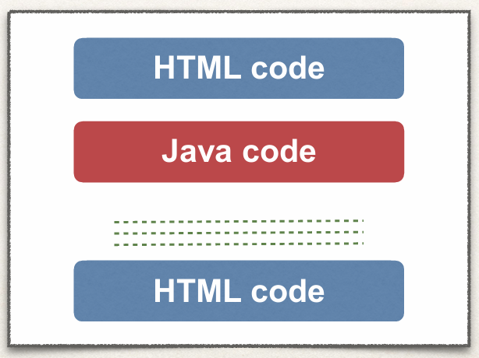
JSP
An HTML page with some Java code sprinkled in…
Include dynamic content from Java code

Slide 15
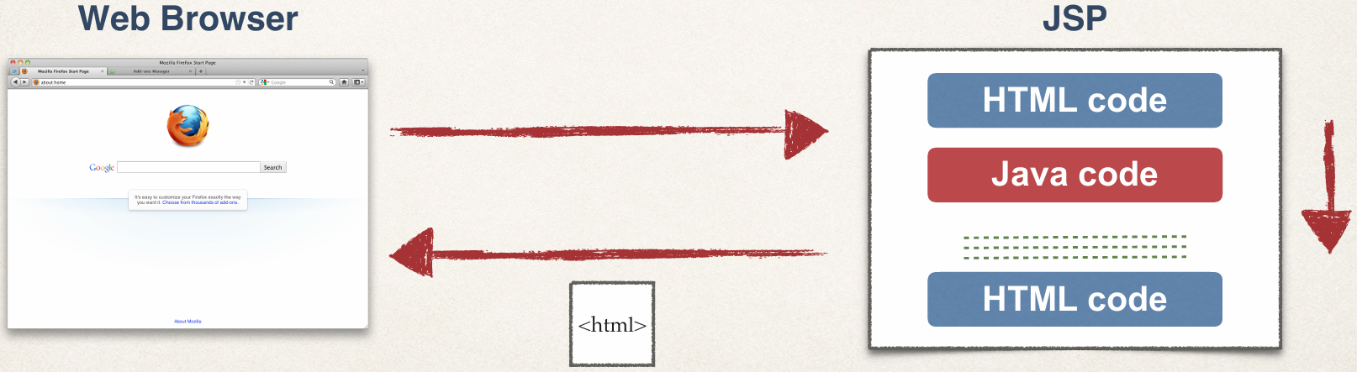
Where is the JSP processed?
JSP is processed on the server
Results of Java code included in HTML returned to browser

Slide 16
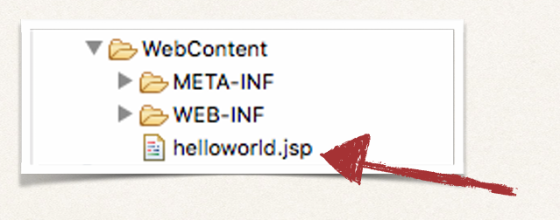
Where to place JSP file?
The JSP file goes in your WebContent folder
Must have .jsp extension

Slide 17
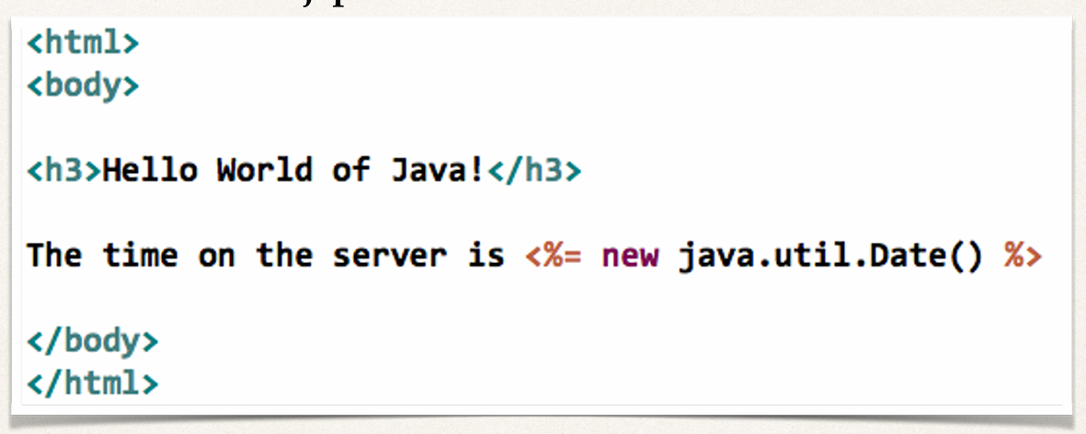
Code
File: helloworld.jsp

Slide 18
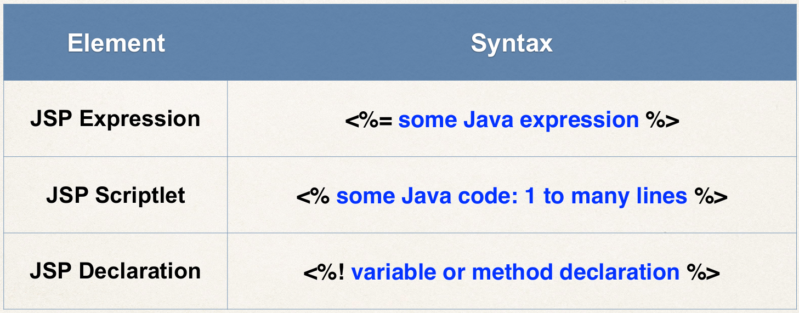
JSP Scripting Elements

Slide 19
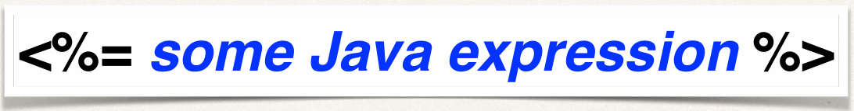
JSP Expression
Compute an expression
Result is included in HTML returned to browser

Slide 20
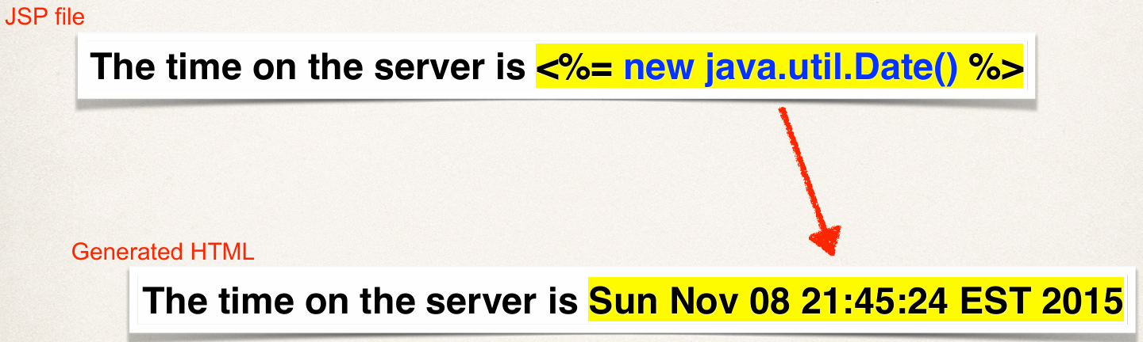
JSP Expression - Example

Slide 21
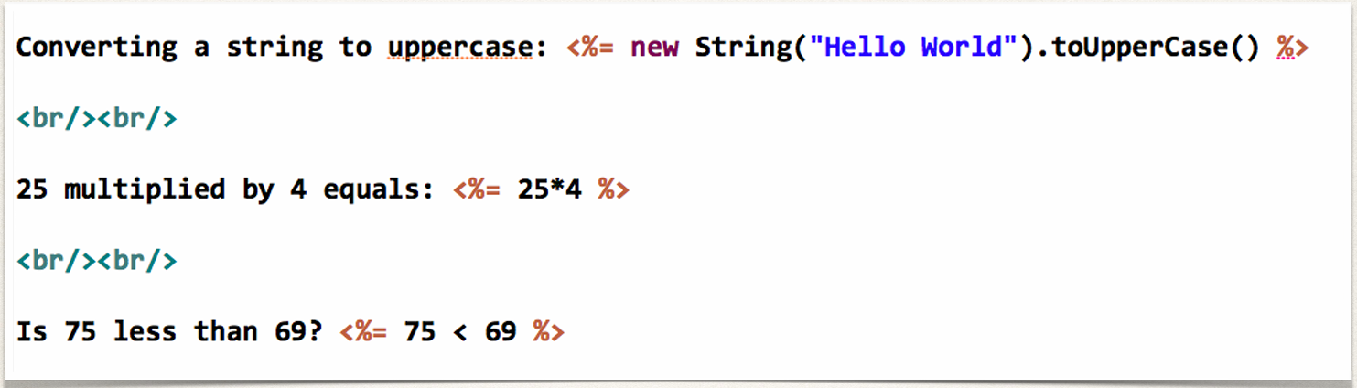
JSP Expression - More Examples

Slide 22
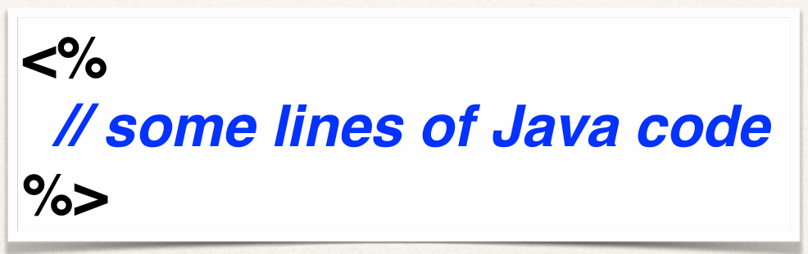
JSP Scriptlets
Insert 1 to many lines of Java code
To include content in the page use: out.println(…)

Slide 23
JSP Scriptlet - Example
Hello World of Java
<%
for (int i=1; I < 5; i++) {
out.println(“Writing good code: “ + i);
}
%>

Slide 24
JSP Scriptlet - Best Practice
Minimize the amount of scriptlet code in a JSP
Avoid dumping thousands of lines of code in a JSP
Refactor this into a separate Java class … make use of MVC

Slide 25
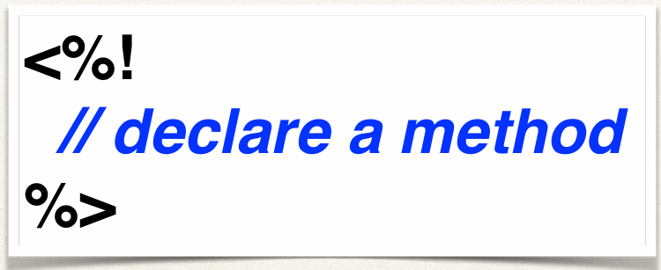
JSP Declarations
Declare a method in the JSP page
Call the method in the same JSP page

Slide 26
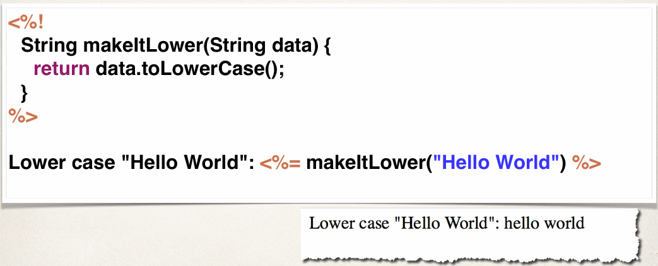
JSP Declaration - Example

Slide 27
JSP Declarations - Best Practice
Minimize the number of declarations in a JSP
Avoid dumping thousands of lines of code in a JSP
Refactor this into a separate Java class … make use of MVC

Slide 28
Call Java Class from JSP

Slide 29
JSP - Best Practice
Minimize the scriptlets and declarations in a JSP
Avoid dumping thousands of lines of code in a JSP
Refactor this into a separate Java class … make use of MVC

Slide 30
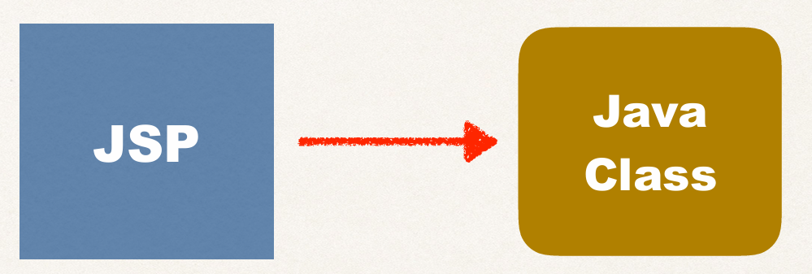
JSP - Best Practice

Slide 32
To Do List
Create Java class
Call Java class from JSP

Slide 33
JSP Built-In Server Objects
Given to you for free
Use them directly in your JSP page

Slide 34
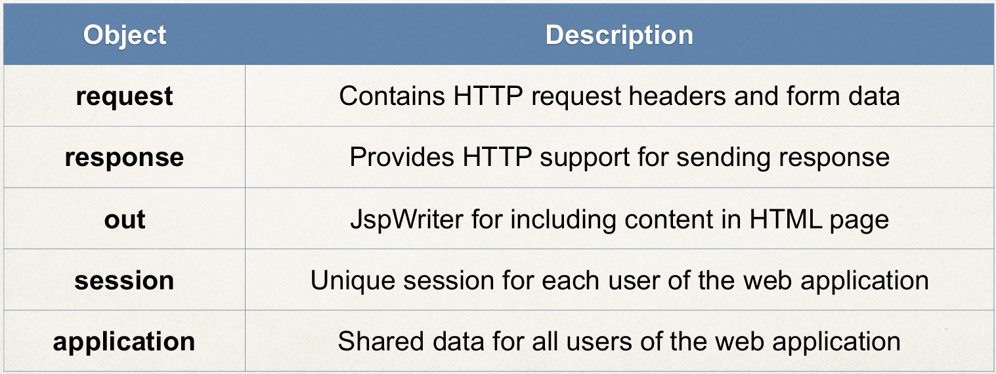
Built-In Server Objects
List of commonly used JSP objects

Slide 35
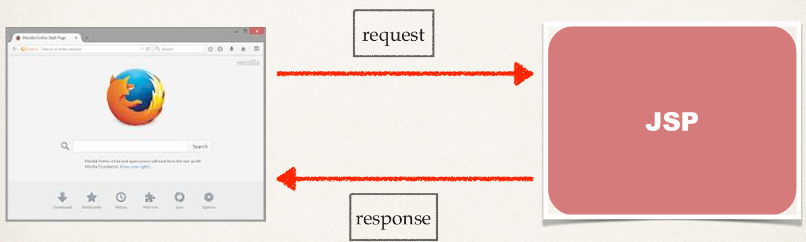
HTTP Request / Response

Slide 36
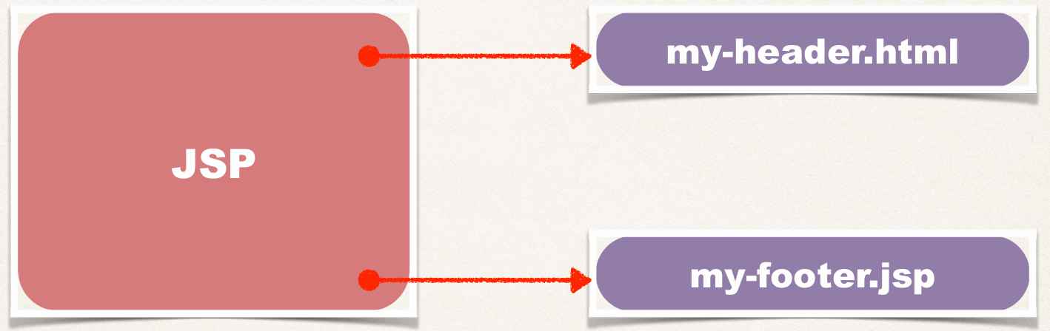
Including Files

Slide 37
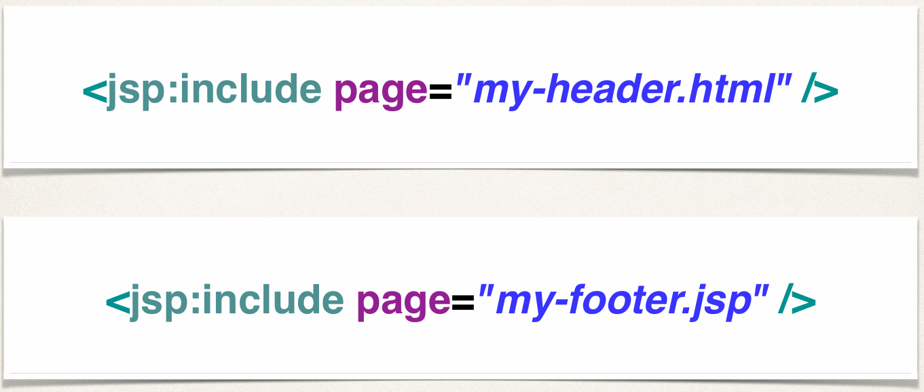
Including Files

